Slide 1

Data mining with Early stage diabetes risk prediction dataset
Group1
Nathan D
Shehnaz I
Thuy T

Slide 2
Table of content
Data Set Selection & Objective
Data Cleaning
Data Reduction
Data Visualization
Data Transformation
Algorithm and Evaluation Methods Selection
Q&A

Slide 3
Data SELECTION & OBJECTIVE
Data Set: Early Stage diabetes risk prediction
Problem: Classify diabetic vs non-diabetic patient at its early stage
Approximately 5 million of the 18 million people with diabetes in the U.S. do not know they have it. Early detection and treatment of diabetes is an important step toward keeping people with diabetes healthy. It can help to reduce the risk of serious complications such as premature heart disease and stroke, blindness, limb amputations, and kidney failure.
Objective: The purpose is to build a model with highest accuracy to classify which patients are getting diabetes given all the symptoms they are experiencing.
Reference: https://aspe.hhs.gov/report/diabetes-national-plan-action/importance-early-diabetes-detection#:~:text=Early%20detection%20and%20treatment%20of,limb%20amputations%2C%20and%20kidney%20failure.

Slide 4
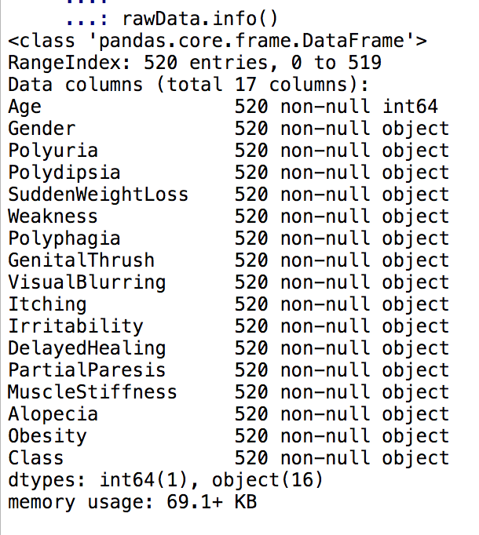
Data Cleaning
17 attributes: 16 categorical + 1 numeric attribute
520 patients
No missing values

Slide 5
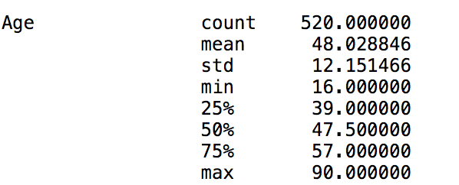
Data cleaning
Boxplot shows 2 outliers. However, when reviewing Min-Max range, Age is in acceptable range.

Slide 6
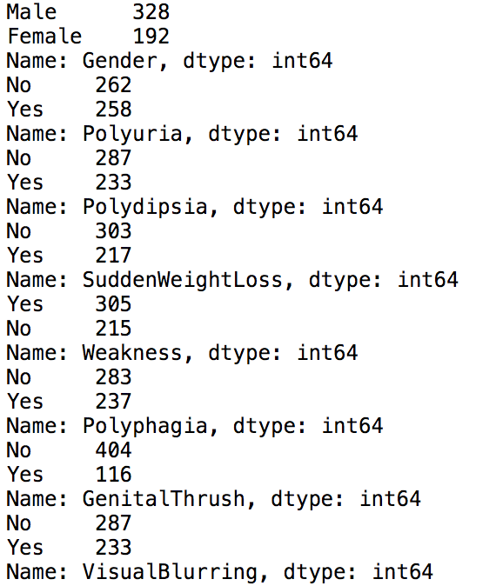
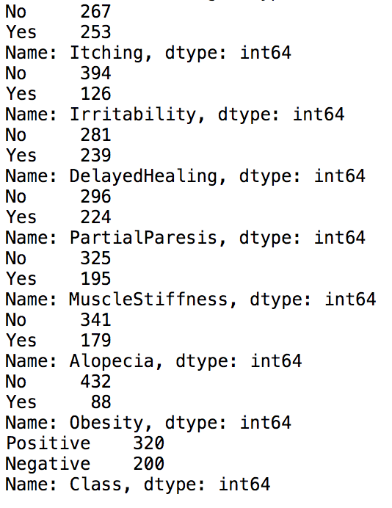
Data cleaning
All values are consistent. No noisy value. Either ’Yes’ or ‘No’, ‘Positive’, or ’Negative’.

Slide 7
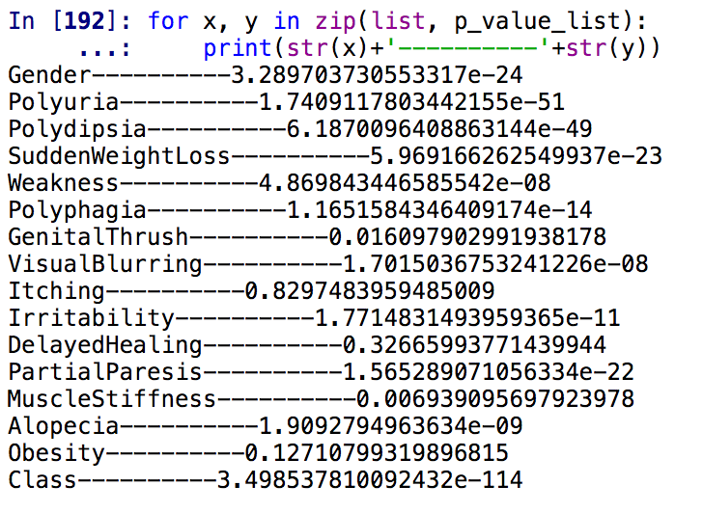
Data reduction
Chi-Square Test
Correlation
At 1% significant level, we can conclude that ﻿'Itching','DelayedHealing','Obesity','GenitalThrush’
are not statistically significant.

Slide 8
Explorative data analysis
Numeric Attribute: Age
Data Distribution: Slightly Skewed(Skewness=0.33|Kurtosis=-0.19)
50% of the age values are in the range of 39 to 57
Being above 70 is more likely to be diagnosed with diabetes

Slide 9
Explorative data analysis
Categorical Attributes
Though number of males are more than female, female is more likely to get diabetes.
Positive cases are 120 cases more than Negative

Slide 10
Explorative data analysis
Categorical Attributes

Slide 11
Data Transformation
Age – Log Transformation
Positive or Yes or Male -> 1
Negative or No or Female -> 0

Slide 12
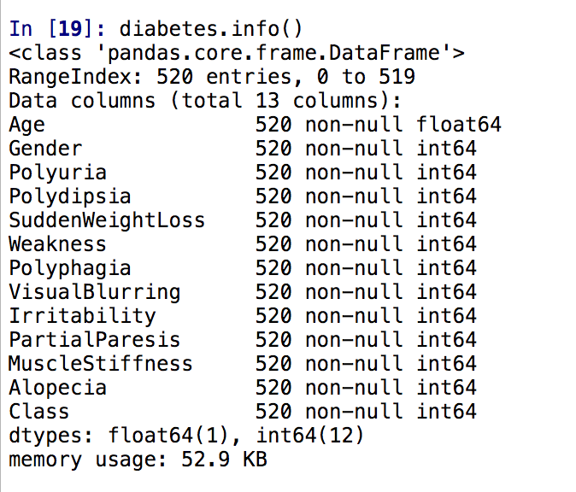
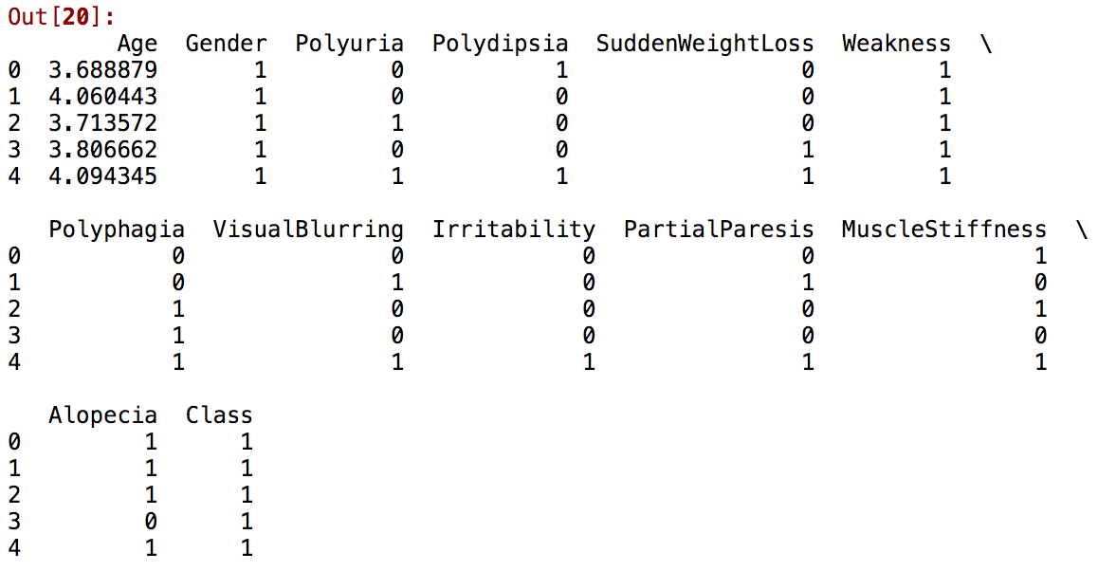
Final data

Slide 13
MODel selection and Evaluation Methods
Evaluation and comparison
Error rate
ROC and AUC
Speed
Algorithm:
Naive Bayesian classier
Articial neural network
AdaBoost

Slide 14
Q&a

